Slide 1
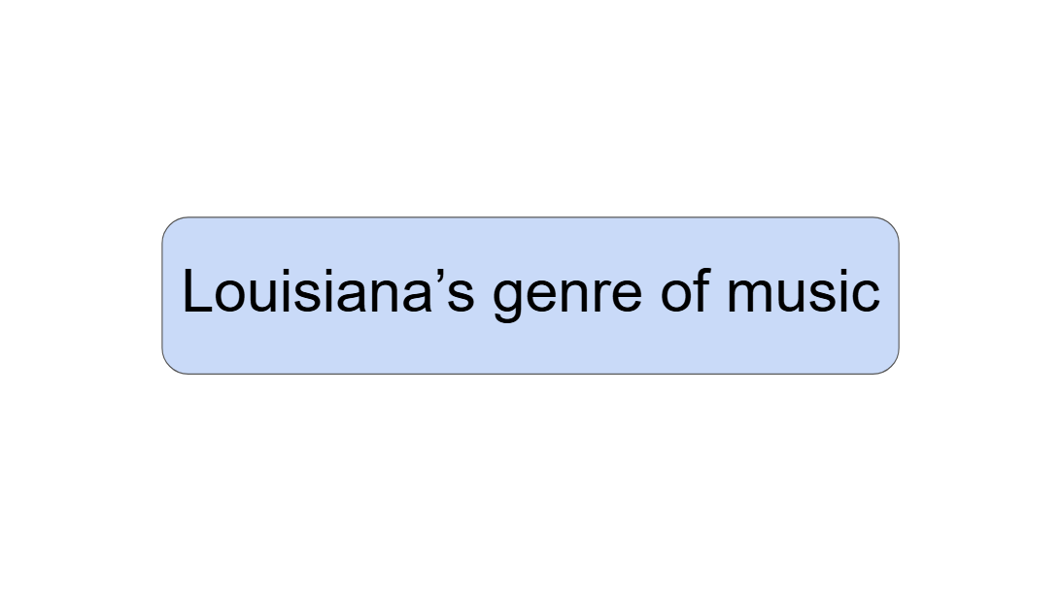
Genres of music
Festivals
Popular dishes
Population

